Slide 1
Functions of Complex Variable
Instructor: 朱哲明 ( )
Zheming Zhu
College of Architecture and Environment, Sichuan University, China
and
Dept. of Civil Engineering, University of Toronto, Canada
Email: am.zhu@utoronto.ca; Tel:13568967156

Slide 2
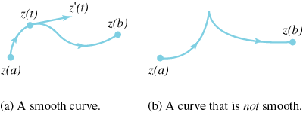
Basic Definitions
In this part, some of the basic definitions and properties of functions of a complex variable are stated as a preliminary to their use in later sections
The curve C is said to be a smooth curve if is continuous and nonzero on the interval .
Thus a smooth curve has no corners or cusps.

Slide 3
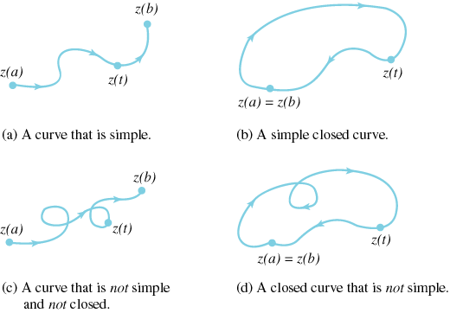
Contours and Contour Integrals
simple and closed curve

Slide 4
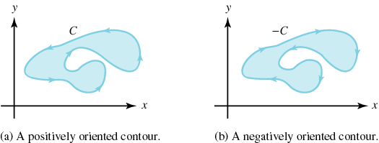
positive and negative orientation
Let the simple closed contour C have the parametrization
for . If C is parametrized so that the interior of C is kept on the left
as z(t) moves around C, then we say that C is oriented positively
(counterclockwise); otherwise, C is oriented negatively (clockwise).
If C is positively oriented, then -C is negatively oriented.

Slide 5
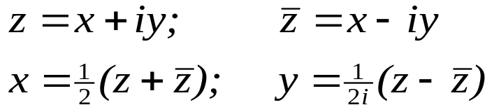
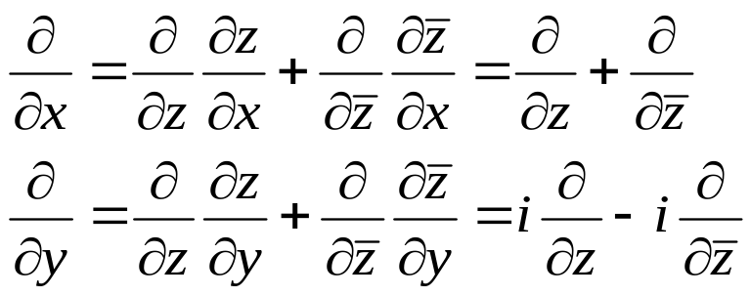
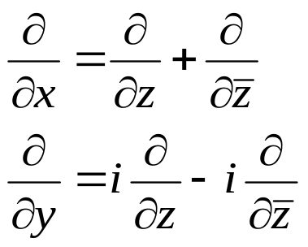
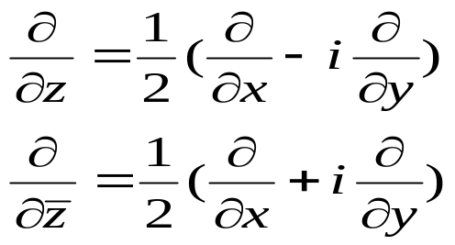
Complex Functions
A complex function
In view of the relations:
and
We have

Slide 6
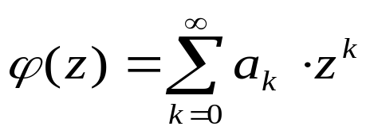
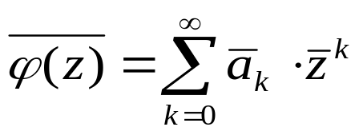
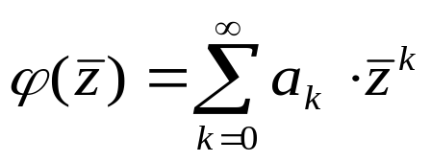
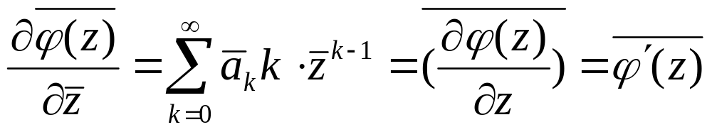
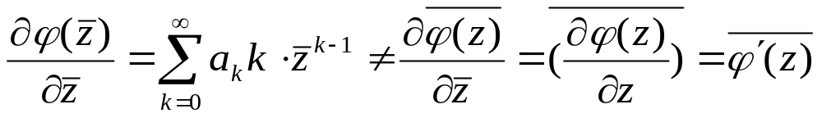

If a_{k} is a complex

Slide 7
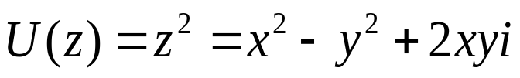
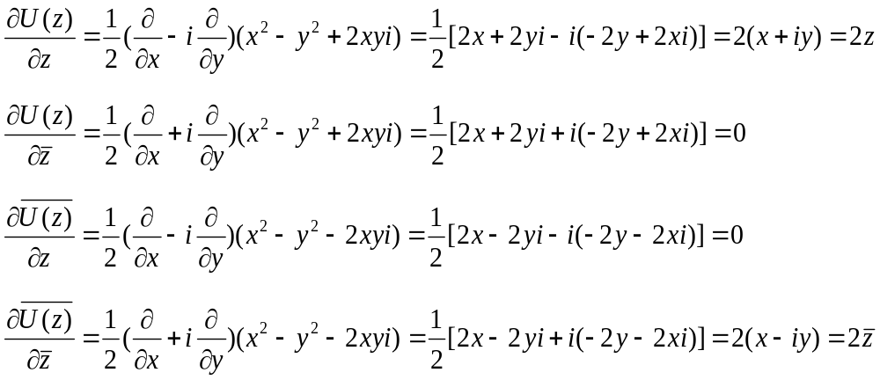
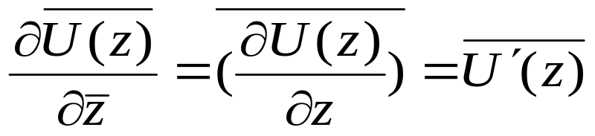
Example (can pass)
If
is analytic then
Therefore,

Slide 8

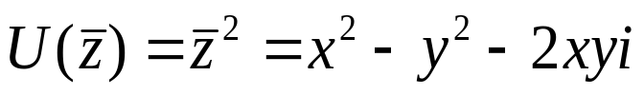
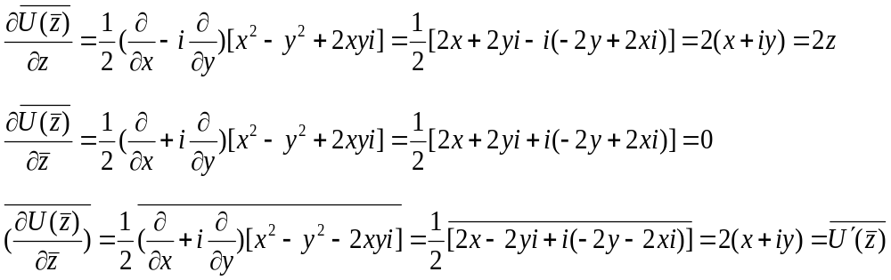
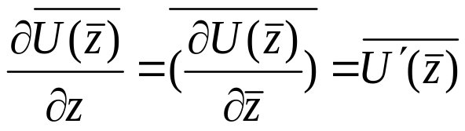
y
Example (can pass)
Z (x,y)
x
(x,-y)
If
then

Slide 9
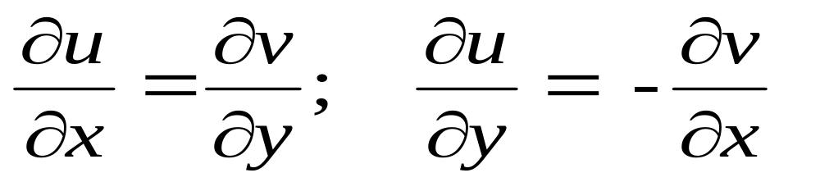
Properties of Analytical Functions
1. If U(z) = u (x, y) + i v (x, y) is analytic in S, then all
derivatives of U(z) exist and are analytic in S , and
Cauchy-Riemann equations are satisfied

Slide 10


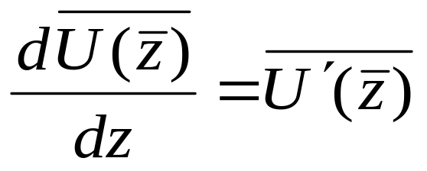
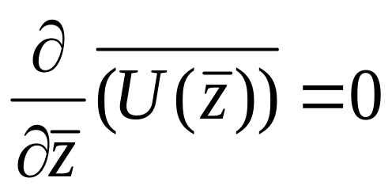
Properties of Analytical Functions
2. If U(z) is an arbitrary analytic function defined in S^{+,} then it is possible to use this function to define an associated complex function which is analytic in the region which is the image of S⁺ at its boundary.
Let us denote the half plane y > 0 by S⁺, and y < 0 by S⁻ . Suppose U(z) is analytic for z ∈ S⁺, then U( ) is defined for all z ∈ S⁻ . We now show that which is defined for all z ∈ S⁻ and moreover
S+,
z
S-
Hence the associated complex function is analytic

Slide 11
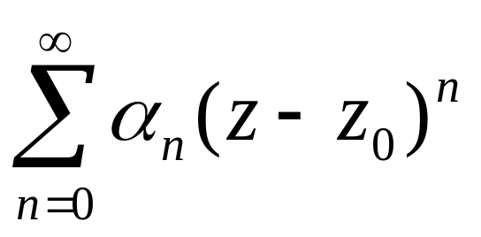
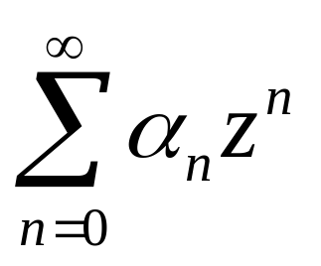
Properties of analytic Functions
3. A analytic function may be represented by a unique uniformly convergent power series of the form
in the neighbourhood of any point z₀ in its analytic region

Slide 12

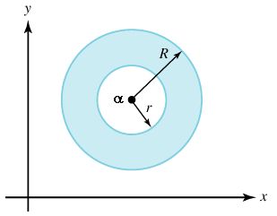

Laurent's Theorem. Suppose , and that f(z) is analytic in
the annulus . If is any
number such that , then for all the function value
has the Laurent series representation
Zo
where for ,
and

Slide 13
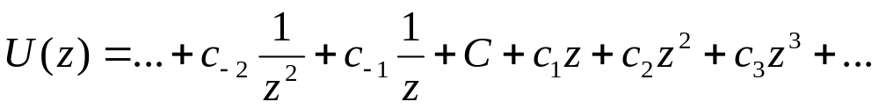
Properties of analytic Functions
4. If U(z) is analytic and single valued in the whole plane including the point at infinity, then U(z) is a constant. This is Liouville’s Theorem
When z = 0, the coefficients of C-n = 0; and When z = ∞ Cn = 0 , n>0

Slide 14
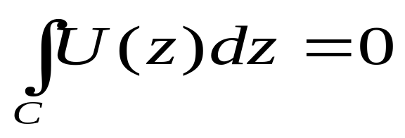
Properties of analytic Functions
5. Cauchy’s Theorem: If U(z) is an analytic function in the region enclosed by a contour C and is continuous on C then
Note that the region enclosed by a single contour C is simply connected

Slide 15
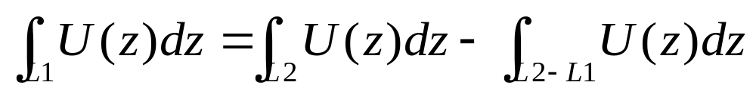
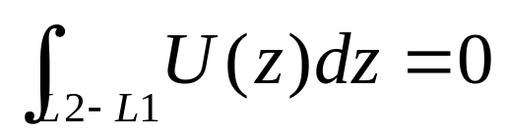
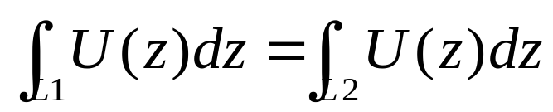
Multiple-valued functions
For a simply connected region S⁺, L1 and L2 are different paths joining z₀ and z
L1
z
z0
L2
According to Cauchy’s Theorem
so
The integral is independent of the choice of the arc L and single valued.

Slide 16
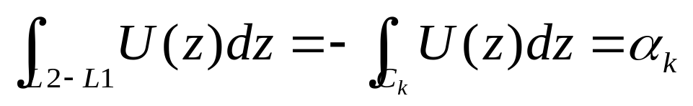
Multiple-valued functions
For multiply connected region S⁺ , considering two arc L1 and L2, which joint the fixed point z₀ to point z on the opposite sides of the cut between C_{k} and C₀. then by Cauchy’s Theorem
C₀
L1
z
z₀
C_{k}
L2
Remembering C_{k} is described clockwise. It increases by a constant α_{k} in a single anticlockwise circuit of a contour surrounding C_{k}

Slide 17
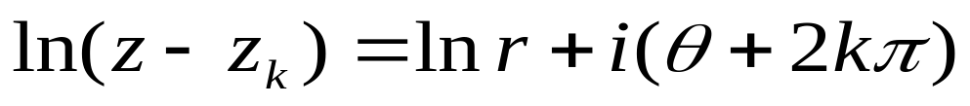
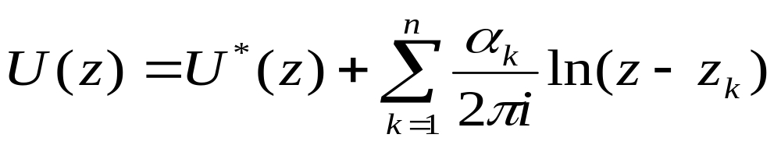
Multiple-valued functions
Considering the function ln(z-z_{k}) where z_{k} is a point in the interior of C_{k}, the ln(z-z_{k}) is analytic and in an anticlockwise circuit around C_{k}, its value increases by 2πi. because
Thus, U(z) has the representation
Ck
C0
z_{k}
Where U* is continuous across the cuts and so is single valued in S⁺
Considering:

Slide 18



Residues at Poles
(i) If f(z) has a simple pole at , then
(ii) If f(z) has a pole of order 2 at , then
(iii) If f(z) has a pole of order 3 at , then
(v) If f(z) has a pole of order k at , then

Slide 19
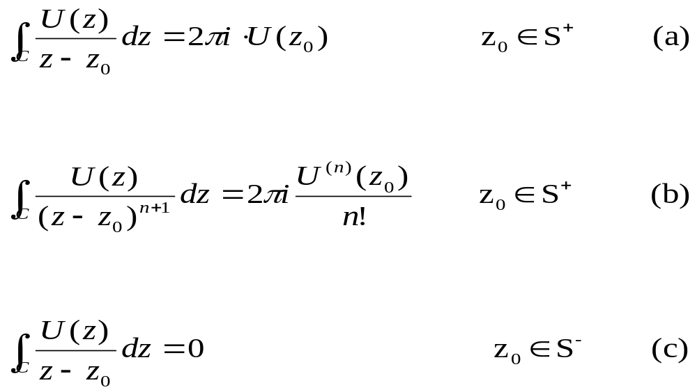
Cauchy integrals
(a) Suppose S⁺ is a finite open simply connected region enclosed by the contour C described in an anticlockwise sense. We denote the region exterior to (S⁺ + C) by S^{-.} Then if U(z) is an analytic function in S⁺ and continuous on C, then
S⁻
z₀
S⁺
C

Slide 20



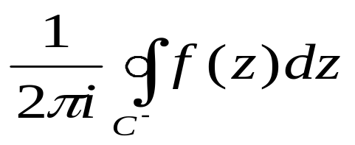
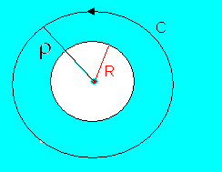
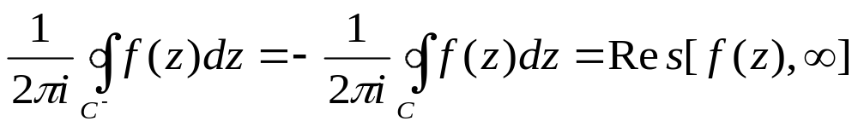
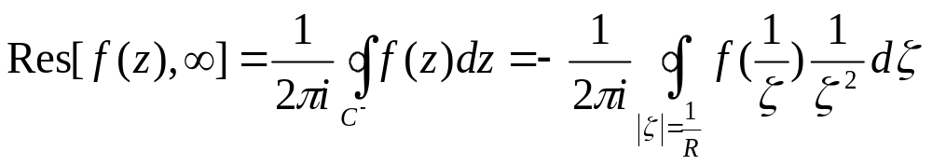
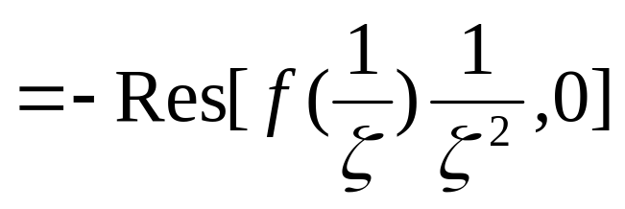
Residue at infinity
Definition: if f(z) is analytic in the annulus
If is a simple closed curve , then the integral
is equal to the residue of f(z) at infinity, i.e.

Slide 21
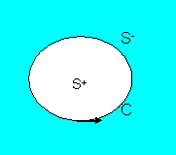
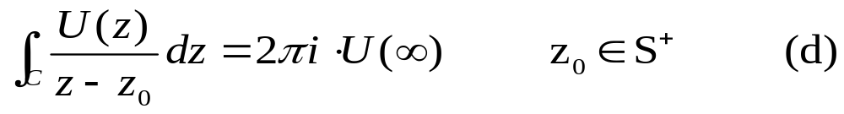
Cauchy integrals
(b) Suppose U(z) is analytic in S^{-.} including the point at infinity and continuous on C (anticlockwise sense), then
z₀

Slide 22
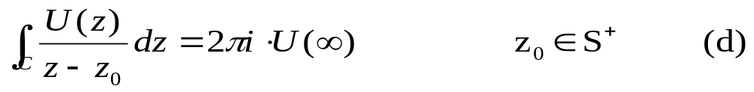
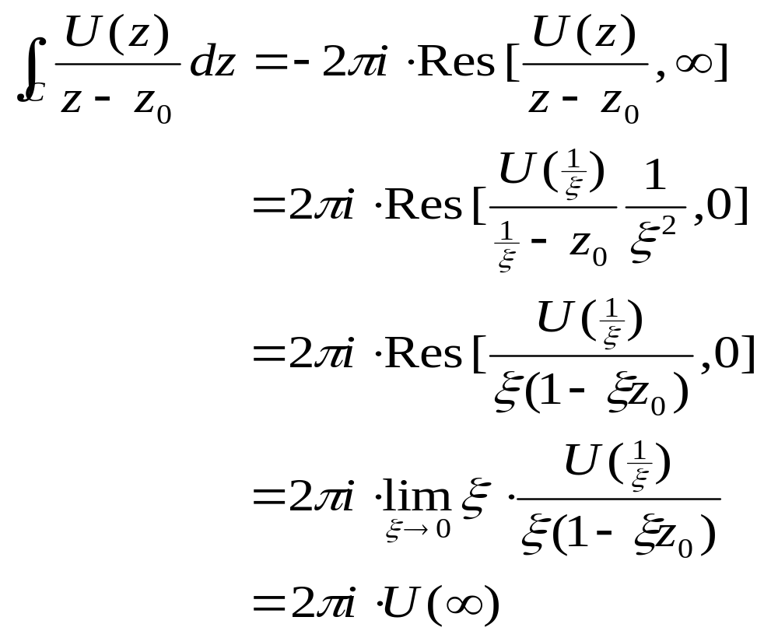
z₀
According to residue theory

Slide 23
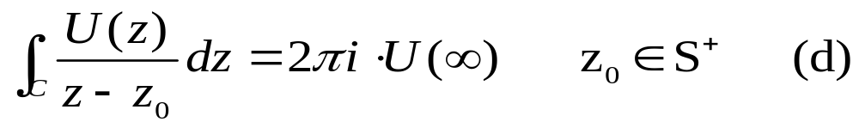
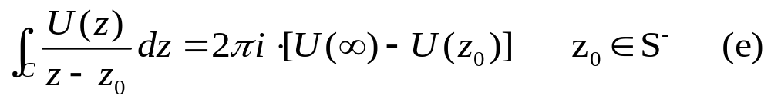
(b) Suppose U(z) is analytic in S^{-.} including the point at infinity and continuous on C (anticlockwise sense), then
z₀
z₀

Slide 24
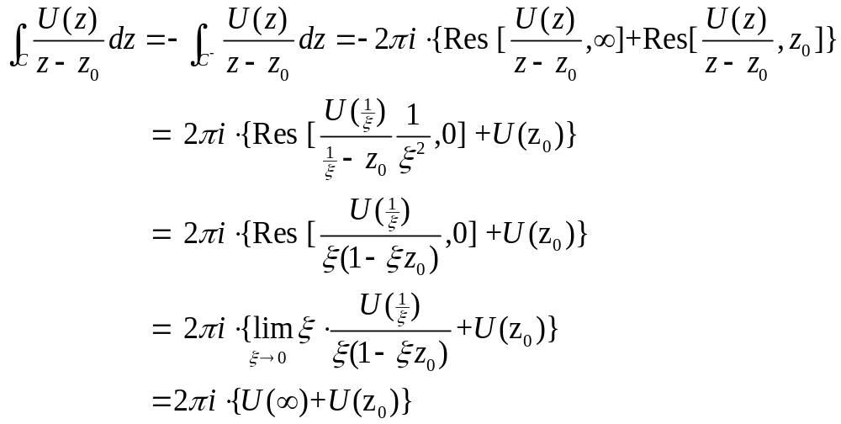
z₀
According to residue theory

Slide 25
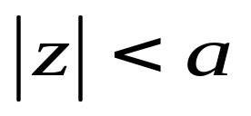
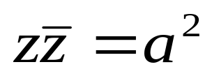
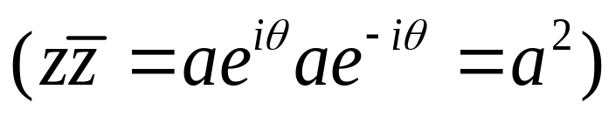
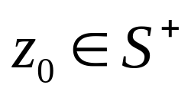

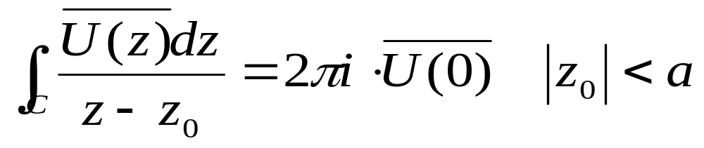
C. Suppose U(z) is analytic in and C is
a circle
and
S⁺
S⁻
C
then

Slide 26





Cauchy integrals
Because U(z) is analytic in and C is the circle
then
S⁺
S⁻
now
is an analytic function in
C
and from
z₀
Where U(z) is analytic in S⁻
The above integral equals
i.e.

Slide 27





Cauchy integrals
Similarly,
Suppose U(z) is analytic in
then
is analytic when
Then, according to
so we have

Slide 28




conditions
A function u(z) defined on an arc L is said to satisfy a
condition on L,
if for any two points t₁ and t₂ on L
U(z)
L
t₂
z₀
t₁
Where A and μ are positive constants and 0 < μ < 1
The Holder condition indicates that is very small or equals zero
Hint:
express weak derivative

Slide 29





Sectionally continuous function ( 部分连续）
If U(z) has a unique limit as ,
L
, t₀ is any point of L, along any path in
t₀
the left neighbourhoods of t₀, defined
z₀
and along any path in the right neighbourhood of t₀, defined ,
If both and exist at all points t₀ of L,
then U(z) is said to be sectionally continuous in the neighbourhood of L

Slide 30


Sectionally analytic （部分解析）
A function is said to be sectionally analytic in a region D cut along the union L (L=L1+L2+…+Ln) of a finite number of non-intersecting arcs if
It is analytic for all z in D – L;
It is sectionally continuous in the neighbourhood of L;
It is such that at an end z₀ of an arc in L
u(z)
Discussion: if
k = 0 ~ 1
This type of singularity is said weak singularity

Slide 31

Cauchy integral on an arc （柯西曲线积分）
Let u(t) be a complex function which satisfies the Holder conditions on an arc L (not a closed contour), then the Cauchy Integral
L
t₀
z₀
C
(note: U vs u are different due to L is not a closed contour)
may be shown to be a scetionally analytic（部分解析） function in the whole plane cut along the arc L.

Slide 32

scetionally analytic function
Further the limiting values U⁺(t₀) and U⁻(t₀) may be shown to exist on L and satisfy the relations
L
t₀
z₀
C
where t₀ is a point of L and the integral in (b) is interpreted as a principal value..

Slide 33



Conditions Discussion
U(z)
L
t₂
condition on L
t₁
z₀
Where A and μ are positive constants and 0 < μ < 1
The Holder condition indicates that is very small or equals zero.
In last page,
Therefore, the function u(z) may be having the property of Sectionally continuous

Slide 34

Cauchy integral on an arc
L
U(z)
z₀
t₀
Where t₀ is a point of L and the integral in (b) is interpreted as a principal value. The assumption u(t) satisfies the Holder condition defined above is sufficient for the existence of the principal value.
These results were first derived by J. Plemelj (1908), and derived in Muskhelishvili’s Singular Integral Equations, so called Plemelj formulae. We note the Plemelj formulae hold true if we replace the single arc L by a union of several non-intersecting arcs or contours.
Question: if we know the condition as in (a) and (b), how about the solution?

Slide 35



Discussion
A fundamental problem occurring in two-dimensional elasticity is to determine a sectionally analytic function U(z), defined in the whole plane cut along a set of arcs L, having a finite degree at infinity and satisfying the boundary condition.
L1
L3
L2
for all points t on L, where k is a constant.

Slide 36

For the simple case of determining a sectionally analytic function U(z) such that U(∞) = 0, and satisfying the boundary condition
L1
L3
L2
Where u(t) satisfies the holder condition on L.
Usually refer this boundary condition as Cauchy boundary conditions

